Slide 1
DS-306 Data Warehousing and Business Intelligence
Topic 5: Logical DW Design
Dr. Khurram Shahzad

Slide 2
Two possibilities of keys
There are two possibilities of defining the keys of dimension levels
  Generating Surrogate keys
  Keeping DB key as DW key

Slide 3
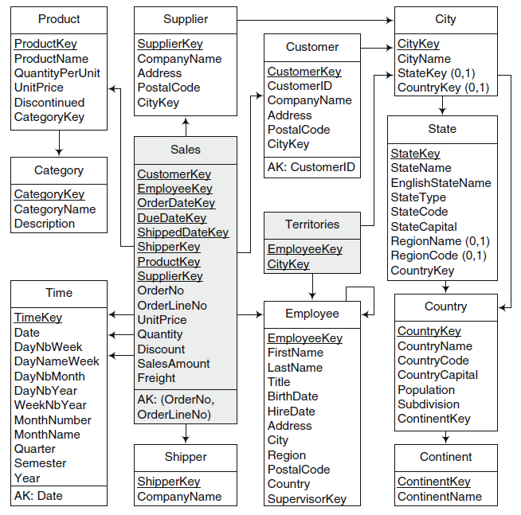
Surrogate key is
added to Customer

Slide 4
Implications of rules
In all rules, surrogate keys are generated for each dimension level
Reasons: Provide independence from keys of the underlying sources
That is, underlying keys can change across time
Also, Surrogate keys are integers that increases efficiency compared to strings

Slide 5
Conceptual to Logical

Slide 6
Relational Implementation
Set of rules are applied to translate conceptual model (MultiDim model) to relational model

Slide 7
Rule 1
A level L, provided that it is not related to a fact with one-to-one relationship, is mapped to table T_{L} that contains all attributes of the level
A surrogate key may be added
  Depending upon the type of changes
Or, the identifier of the level will be the key of the table

Slide 8
Rule 2
A fact F is mapped to a table T_{F} that includes as attributes all measures of the fact
Further, a surrogate key may be added to the table

Slide 9
Rule 3
A relationship between either a fact F and a dimension level L, or between dimension level L_{P} and L_{C} (parent child) can be mapped in three different ways
  One-to-one relation
  One-to-many relation
  Many-to many

Slide 10
Rule 3a
Rule 3a: If the relationship is one-to-one, the table corresponding to the fact T_{F} or to the child T_{C} is extended with all the attributes of dimension level or the parent level

Slide 11
OrderNo
OrderlineNo
are dimensions but
included in fact table

Slide 12
Rule 3b
Rule 3b: If the relationship is one-to-many, the table corresponding to the fact T_{F} or to the child level T_{C} is extended with the surrogate key of the table corresponding to the dimension level T_{L} or the parent level
That is, a foreign key in the fact or child table pointing to the other table

Slide 13
Product, Supplier
Have 1:M relationship

Slide 14
Rule 3c
Rule 3c: If the relationship is many-to-many, a new table T_{B} (bridge table) is created that contains as attributes the surrogate keys to the corresponding to the fact T_{F} and the dimension level T_{L}, or the parent T_{P} and child level T_{C}
The key of the table is the combination of both surrogate keys

Slide 15
Many-to-Many Relationship
Many-to-many relationship parent-child relationship between Employee and territory is mapped to the table territories containing two foreign keys

Slide 16
Employee, City
have M:M relation
New table is added

Slide 17
Time Dimension
DW is historical DB. So, time dimension is present in every DW
Time information is included both as foreign keys in a fact table
Contains aggregation level in which facts can be aggregated across time
This information is defined from DATE

Slide 18
Logical representation of hierarchies

Slide 19
Recall, Dimensional Hierarchies
Types of dimensional hierarchies
  Balanced Hierarchies
  Unbalanced Hierarchies
  Generalized Hierarchies
  Alternative Hierarchies
  Parallel Hierarchies
  Nonstrict Hierarchies

Slide 20
Balanced Hierarchies
Recall,
  A balanced hierarchy has only one path where all the levels are mandatory
  All the branches have the same length
Levels of dimension hierarchies are represented indepdentently
Are linked by parent-child relationships
Snowflake schema

Slide 21
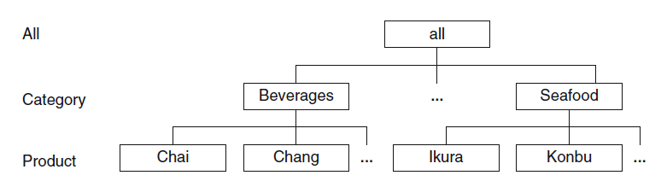
Balanced Hierarchies
Balanced Hierarchy (instance level)

Slide 22
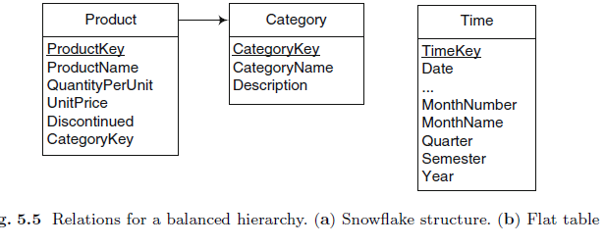
Balanced Hierarchies: Logical
Example snowflake structure on left
Flat table on right (denormalized table), if star is required
  May contain several levels

Slide 23
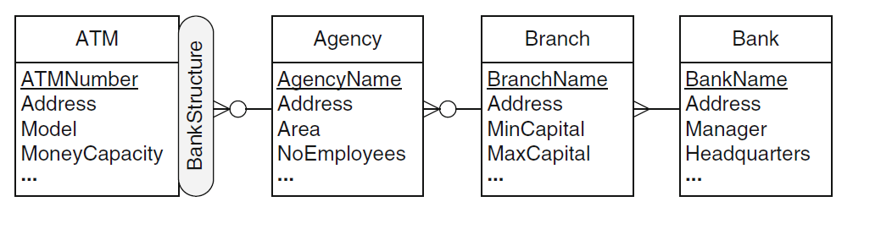
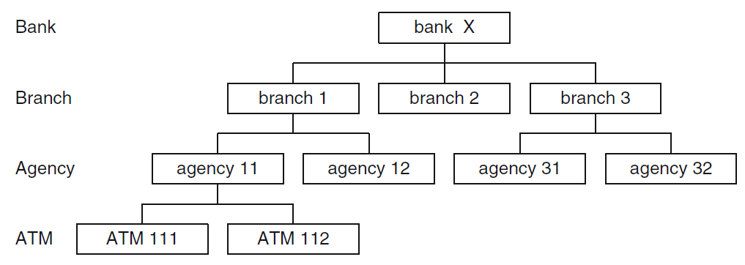
Unbalanced Hierarchies: Conceptual

Slide 24
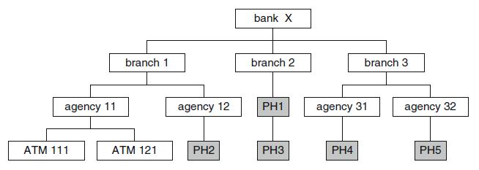
Unbalanced Hierarchies: Logical
Problem: Measures are associated with ATMs
  Measures will aggregate only for those agencies that have ATMS
Solution: Transform unbalanced hierarchy to balanced using placeholders

Slide 25
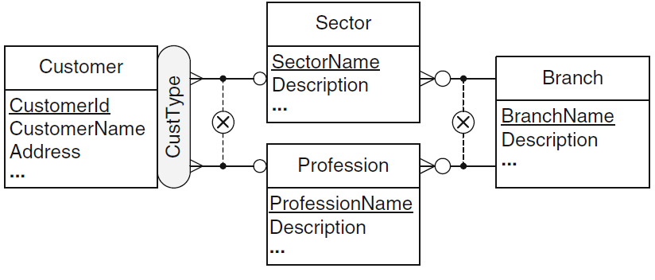
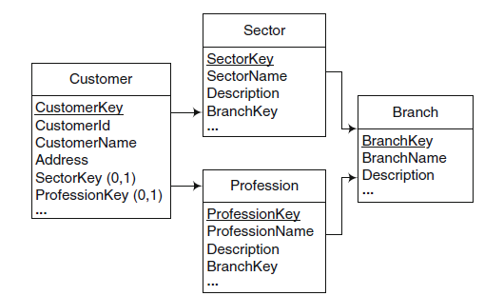
Generalized Hierarchies: Logical

Slide 26
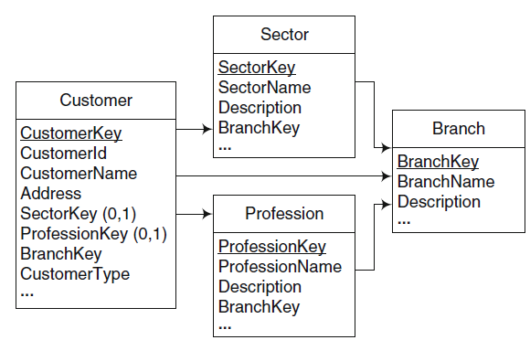
Generalized Hierarchies: Logical
Improved

Slide 27
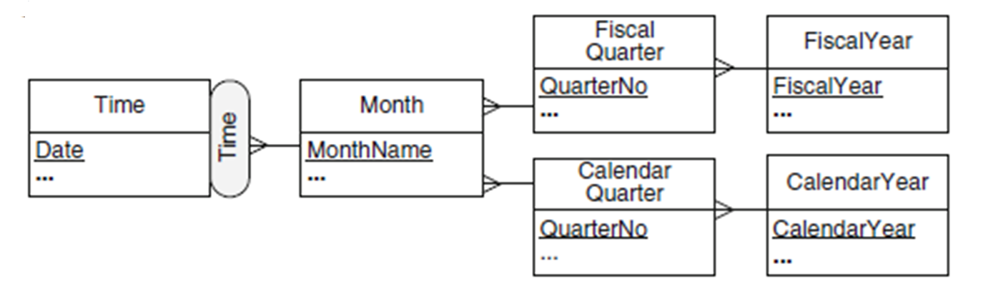
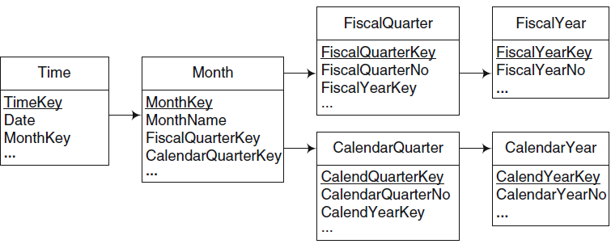
Alternative Hierarchy: Logical

Slide 28
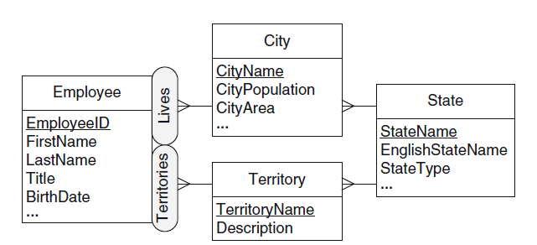
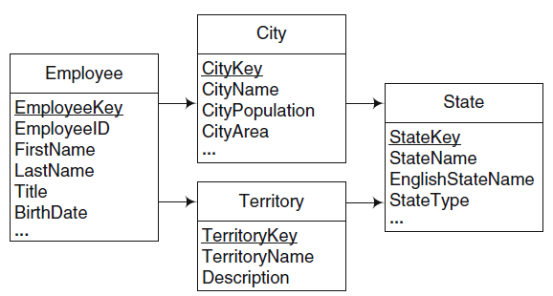
Parallel Dependent hierarchies

Slide 29
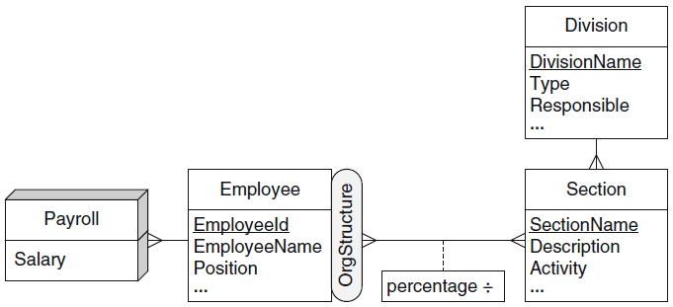
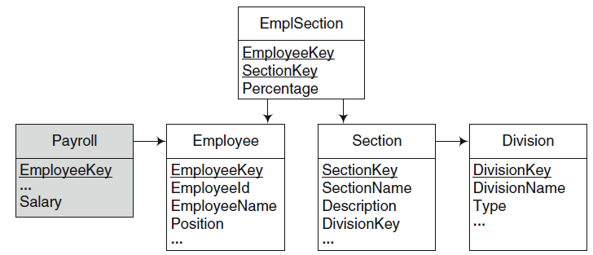
Parallel Nonstrict hierarchies

Slide 30
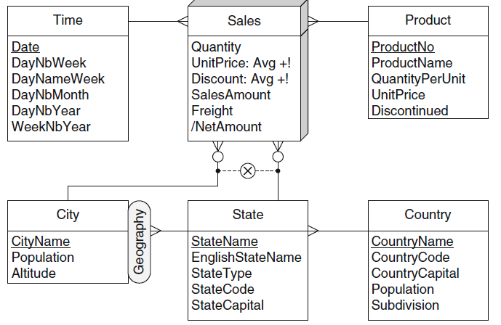
Multiple granularities for the sales fact

Slide 31
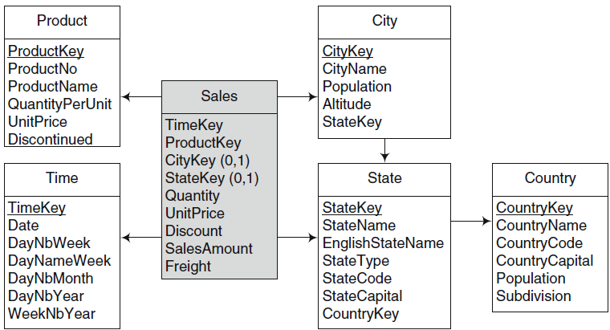
Multiple granularities for the sales fact

Slide 32
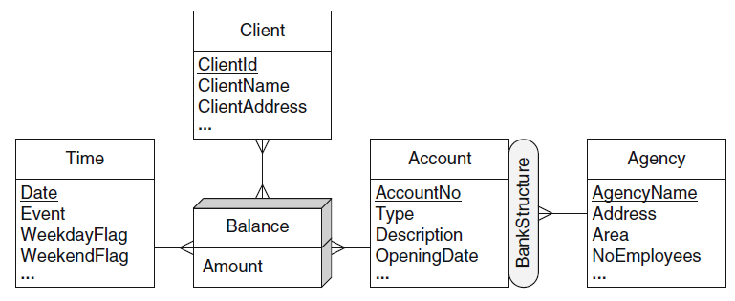
Many-to-Many Dimensions

Slide 33
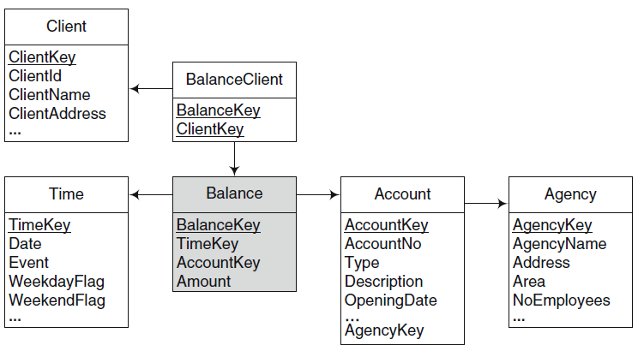
Many-to-Many Dimensions

Slide 34
Lab Case Study
Lab 3 Case Study

Slide 35
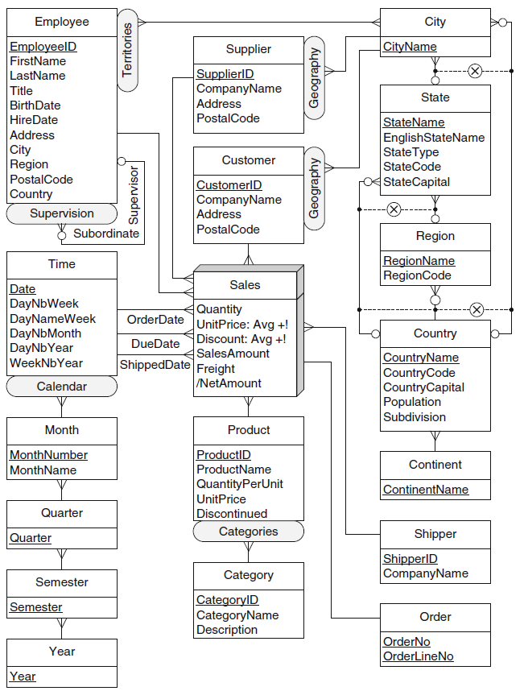
Conceptual Model

Slide 36
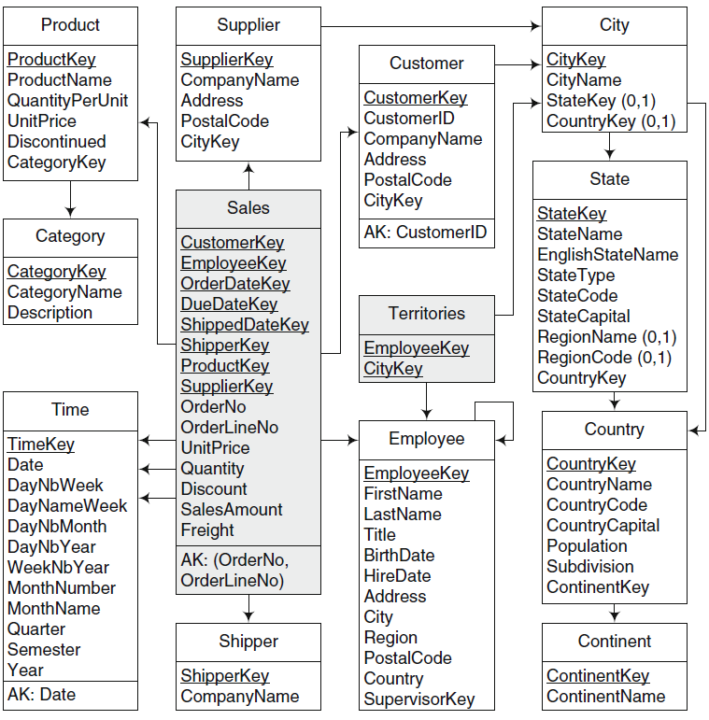
Logical Model

